Slide 1
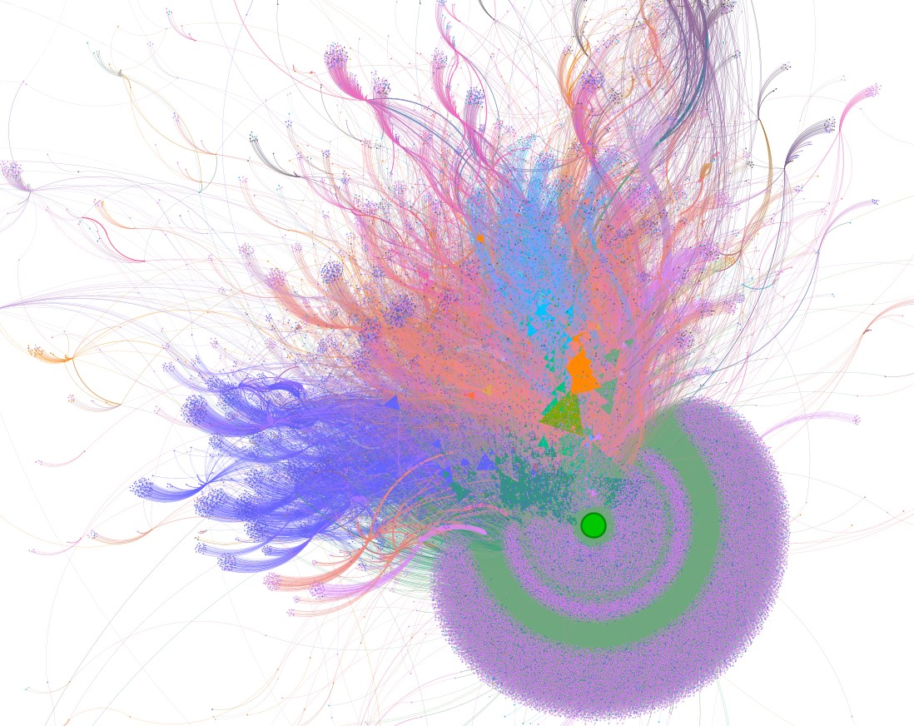
How the US Presidential Elections and the Capitol Attack Shaped the Online Hate Landscape
by Akshay Verma MS Data Science

Slide 2
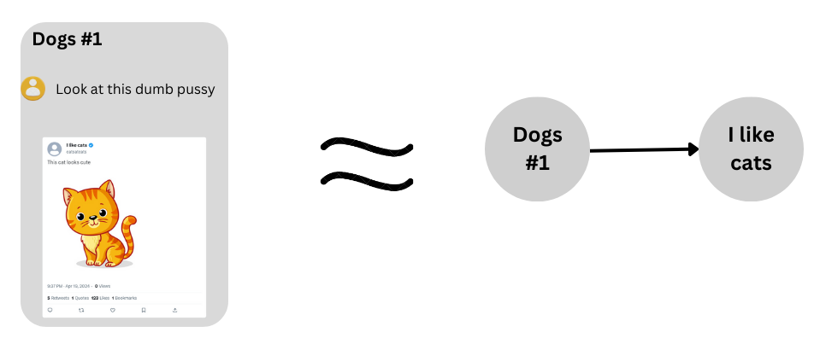
How the Data was collected
Started by Identifying Hate Communities
Monitored the Communities for Cross-Posts
If a user in a hate community posted a link to another community, a directed edge was established from the hate community towards the linked community
While all the source nodes belong to identified hate communities, the target nodes may or may not belong to identified hate communities.
In addition to monitoring cross-posting activities within these hate communities, the posts were also classified to identify text targeting race, gender, religion, anti semitism, gender identity/sexual orientation (GISO), immigration, and ethnicity/identitarian/nationalism (EIN)

Slide 3
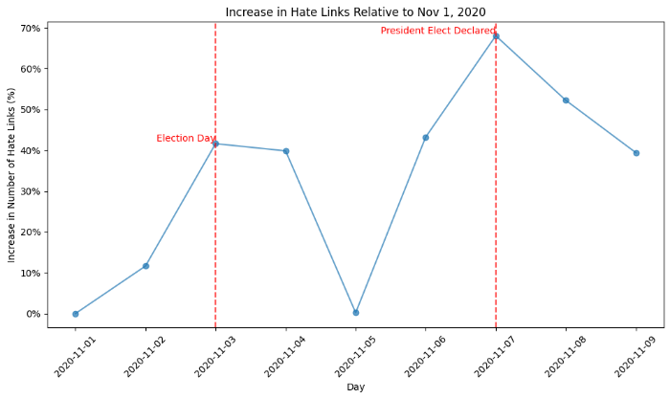
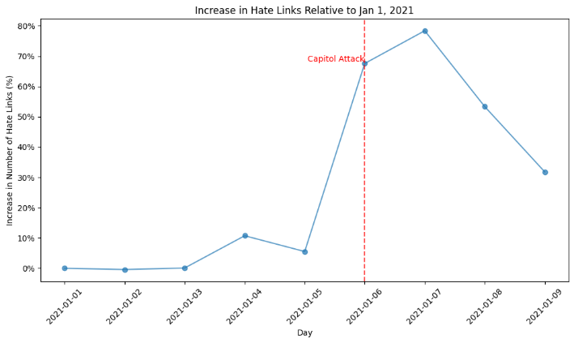
What I noticed
40% increase in hate links on the day of election
70% increase on the day of result.
70% increase on the day of Capitol attacks

Slide 4
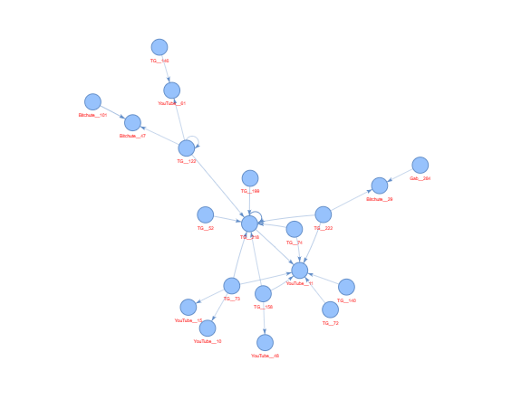
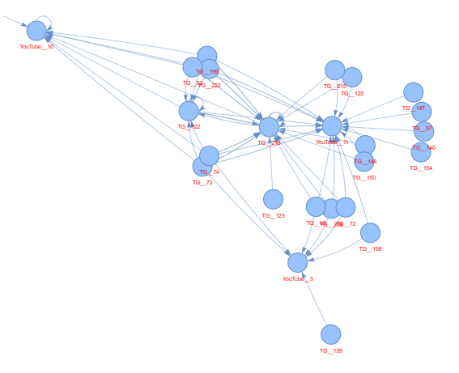
What did the increase resulted in:
Increase in Cohesion
Increase in Clustering
160% increase in clustering coefficient after the Capitol Attacks and 13% after the Elections
An increase in clustering coefficient means that a greater proportion of neighboring nodes are forming closed triangles, enhancing local network cohesion
Individual nodes within the hate network became more interconnected and entrenched within their specific group

Slide 5
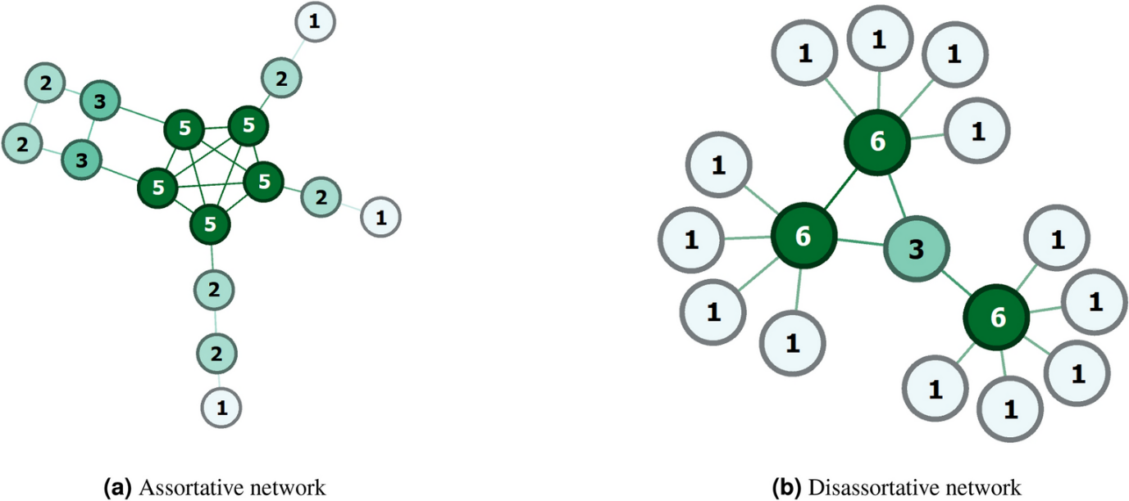
Increase in Assortativity
What did the increase resulted in:
25.1% increase in Assortativity after the Capitol attacks
The important hubs in each cluster are connecting to each other more after the attacks
Implies a greater transfer of information and traffic between the prominent hate spreaders
Leads to strengthening of existing ideologies within the network, fostering a more homogenous and an environment resilient to outside intervention
Assortative networks connect similar nodes (birds of a feather flock together), while disassortative networks connect different ones (opposites attract).

Slide 6
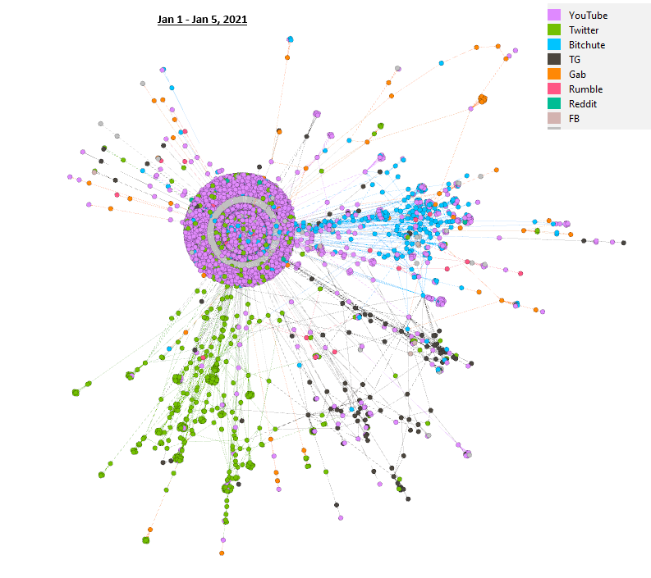
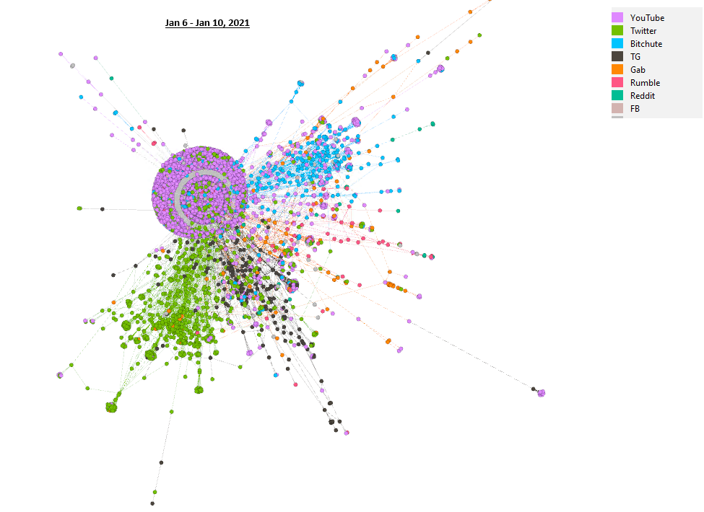
Individual communities joining to become larger community
What did the increase resulted in:
19.8% decrease in the number of communities after capitol attacks
16.72% increase in the size of the largest community after capitol attacks
What it means - Smaller communities getting absorbed into the larger community
What it implies - Suggests a potential convergence towards a more unified ideology.

Slide 7
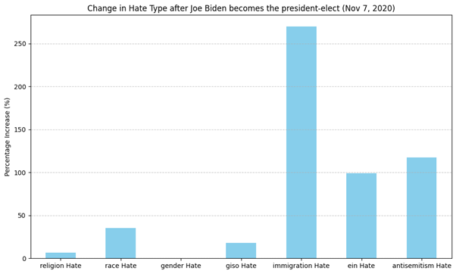
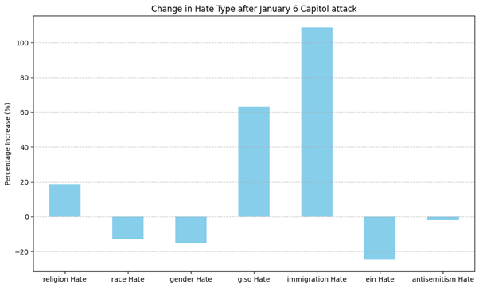
So what changed inside the network
Following the election results a 269.5% surge in anti-immigration sentiments, a 98.7% rise in ethnically-based hatred, and a 117.57% escalation in expressions of antisemitism
These trends are indicative of the immigration anxieties harbored by far-right communities, which often align with the Great Replacement conspiracy theory, attributing perceived demographic shifts to Jewish influence
Following the Capitol attack on January 6th, a comparable increase in anti-immigration sentiments was evident, with a notable 108.69%

Slide 8
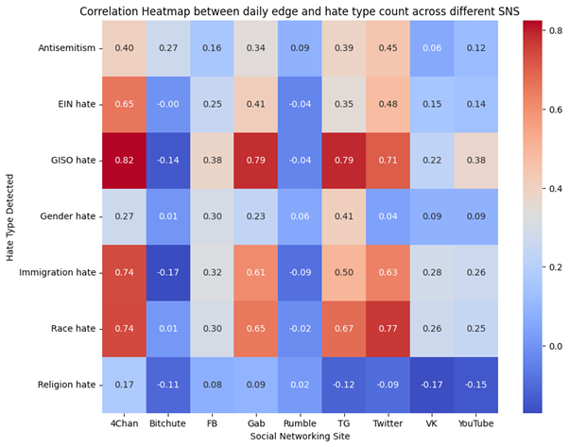
So, Who did it?
Increase in Activity from 4chan, Gab, Telegram, and Twitter is strongly correlated to increase in hate speech targeting Race, Immigration, and Gender Identity.
These platforms share characteristics of limited content moderation and a focus on user anonymity.

Slide 9

So, Who did it?
4chan is an imageboard website known for its lack of user accounts, and diverse boards covering a wide range of topic and controversial discussions.
4chan is overwhelmingly the biggest Hub of traffic in the Hate Network

Slide 10
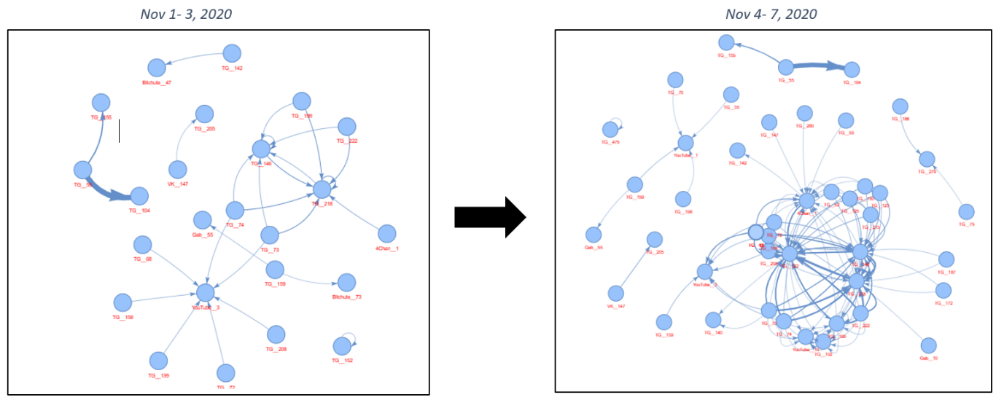
So, Who did it? Telegram
300% increase in the number of connections involving Telegram after the elections
Telegram’s representation as a target node increased from 18.22% to 33.47%, while its presence as a source node increased from 21.73% to 37.24% of all links present in the hate core network after election
Community of interest - “US Voter Fraud & Coup-OpsIntel 2020– 2022” a telegram channel which was initially absent from the network between before the elections, rapidly ascended to become one of the most crucial and interconnected nodes after the election.
Moreover, it exhibits strong associations with two other Telegram channels, one called the reality report a right wing podcast, and another right-wing telegram channel named "Exposing Cultural Marxism", both of which were highly active in the network before the elections..

Slide 11
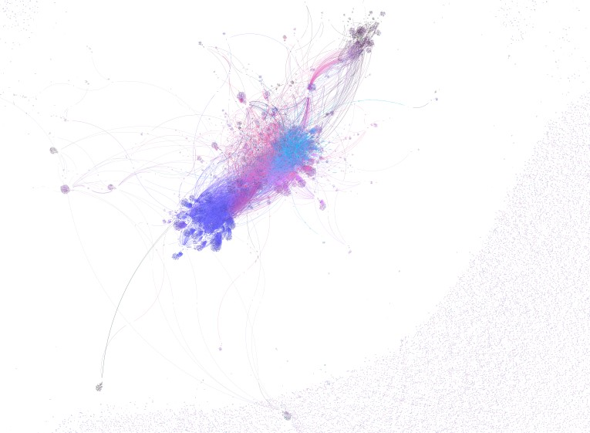
What can be done
Containment of the important hate spreaders
Knocking out 4Chan and Telegram drastically decreases the cohesion in the network
This directly translates to stopping to the proliferation of hate speech
The clustering coefficient decreased by 57%, the size of the largest community decreases by 72%, and the number of communities increase by 47473%.

Slide 12
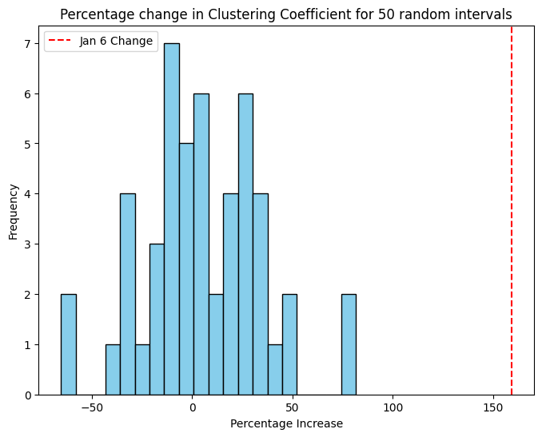
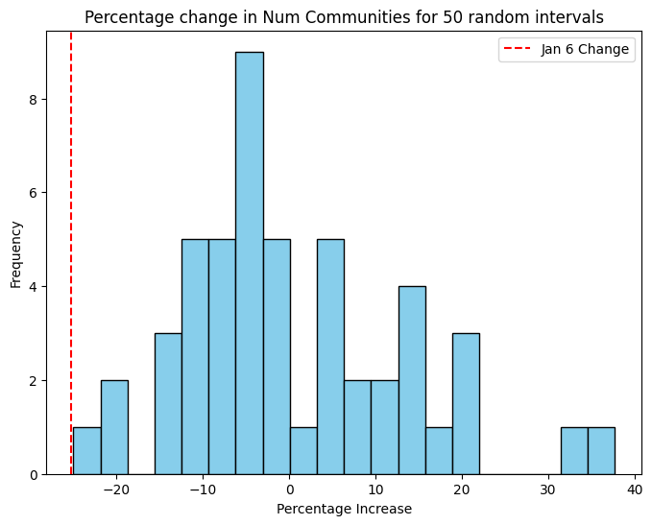
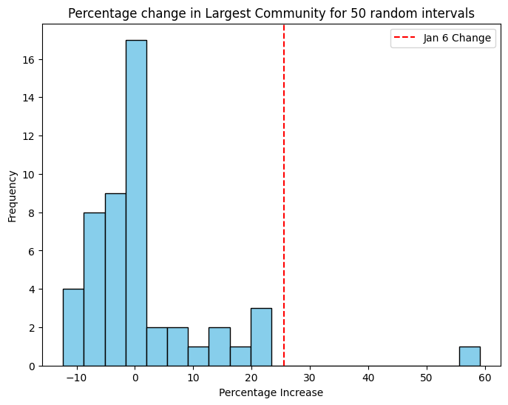
How these results differ from any random interval

